Slide 1
DATA SCIENCE HACKATHON
Metal Slugs IBA

Slide 2

The Burning Question
How can we Machine Learning make the Blood Screening Process more efficient?

Slide 3
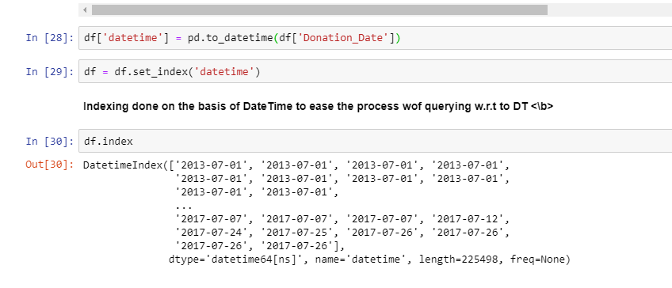
A Time Series Analysis of the Number of Donors who Failed the Blood Tests

Slide 4
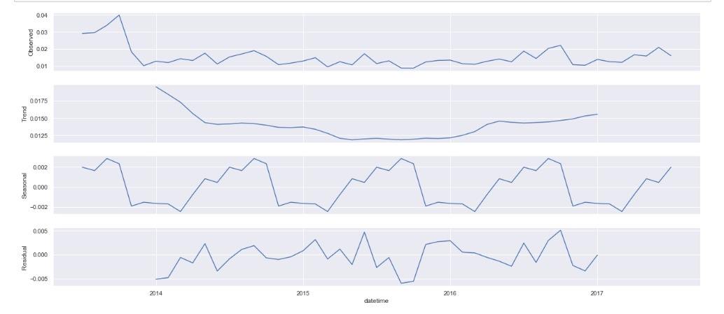
As we can see from the graph below, the seasonal traits seem to fluctuate with a pattern. During the Summer of each season we experience a surge in the amount of failed tests which can tell us a lot about the cost incurred during the blood loss in the Summer Season. Therefore, Hussaini Blood Bank can relax their screening process in the other months.

Slide 5
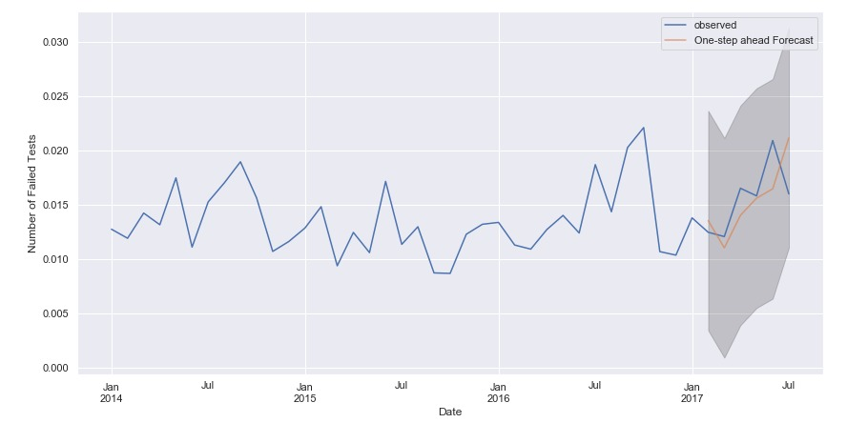
Forecast Model

Slide 6
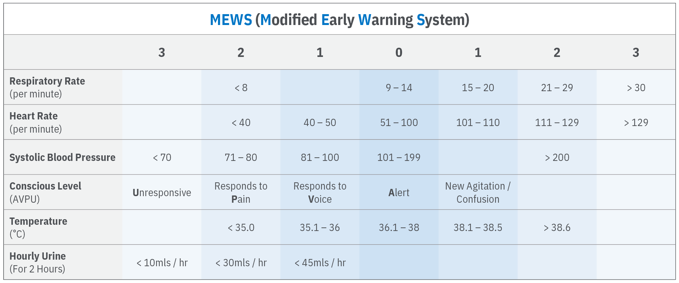
We suggest using a MEW-Score as a measure to indicate a healthy blood donor on the basis of vital signs.

